Slide 1
Machine Learning (ML) and its Applications
Dr. Hafeez Anwar

Slide 2
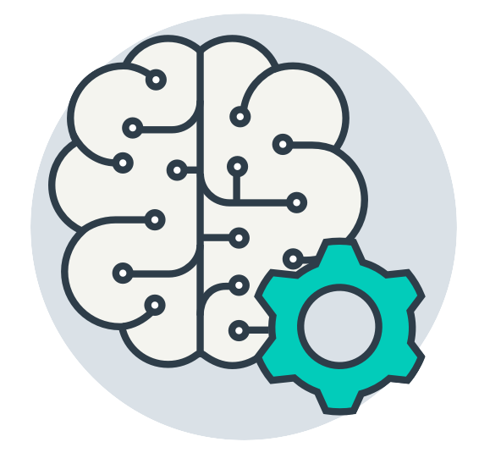
What is ML?
credit: Sung Kim at PyTorchZerotoALL
Notes:
What is ML?

Slide 3

What is Human Intelligence?
Notes:
How about human intelegene?

Slide 4
What is Human Intelligence?
What to eat for lunch?

Slide 5

What is Human Intelligence?
What to eat for lunch?
Information

Slide 6
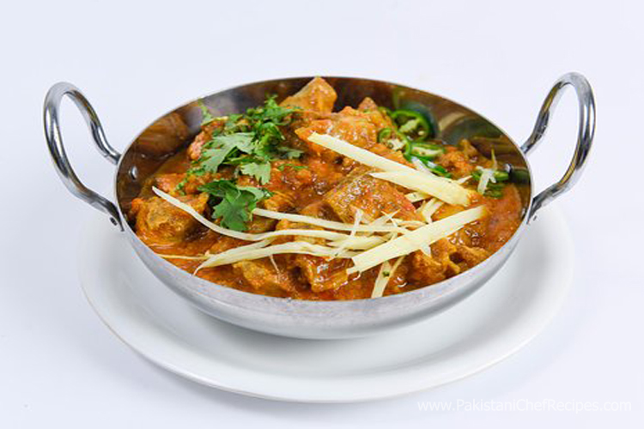
What is Human Intelligence?
What to eat for lunch?
Information
Infer

Slide 7
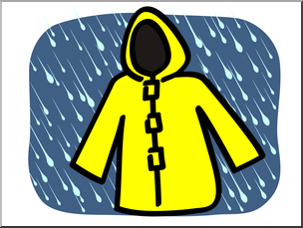
What is Human Intelligence?
What to dress?
Information
Infer

Slide 8
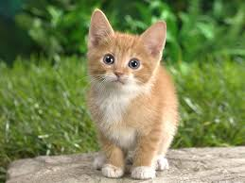
What is Human Intelligence?
What is this picture?
CAT
Image information
Prediction

Slide 9

What is Human Intelligence?
What is this number?
2
Image information
Prediction

Slide 10
What is Human Intelligence?
What would be the grade if I study 4 hours?
4 hours
? points
information
Prediction

Slide 11
Machine Learning
What to dress?
Information
Infer

Slide 12
Machine Learning
What is this picture?
CAT
Image information
Prediction

Slide 13
Machine Learning
What is this number?
2
Image information
Prediction

Slide 14
Machine Learning
What would be the grade if I study 4 hours?
4 hours
? points
information
Prediction

Slide 15

Is ML that simple?

Slide 16
Is ML that simple?
TOOK ME THREE YEARS (PhD) to TEACH this to a COMPUTER…

Slide 17
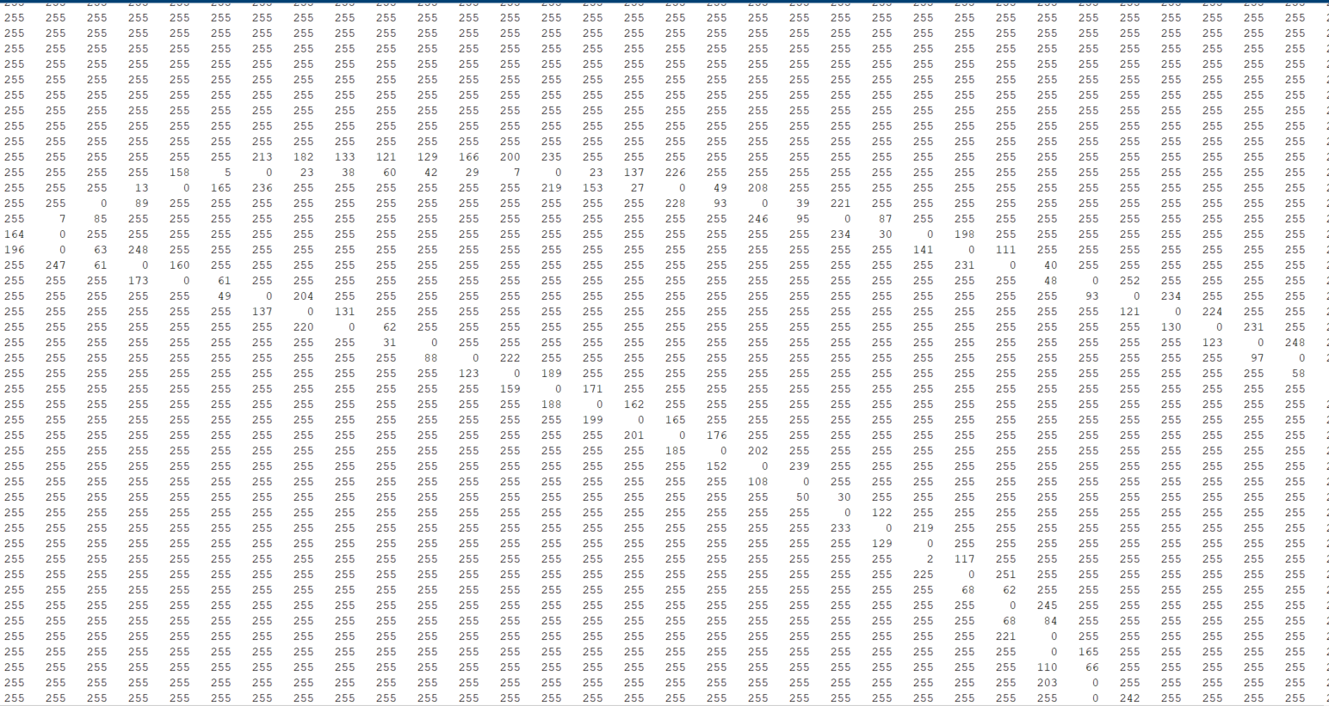
Why?

Slide 18
Why?
Rotations
Scale
Deformations
Color
Texture
Illumination
Position
Medium (air, water, raining etc)

Slide 19
Traditional (explicit) programming to recognize the hand

Slide 20
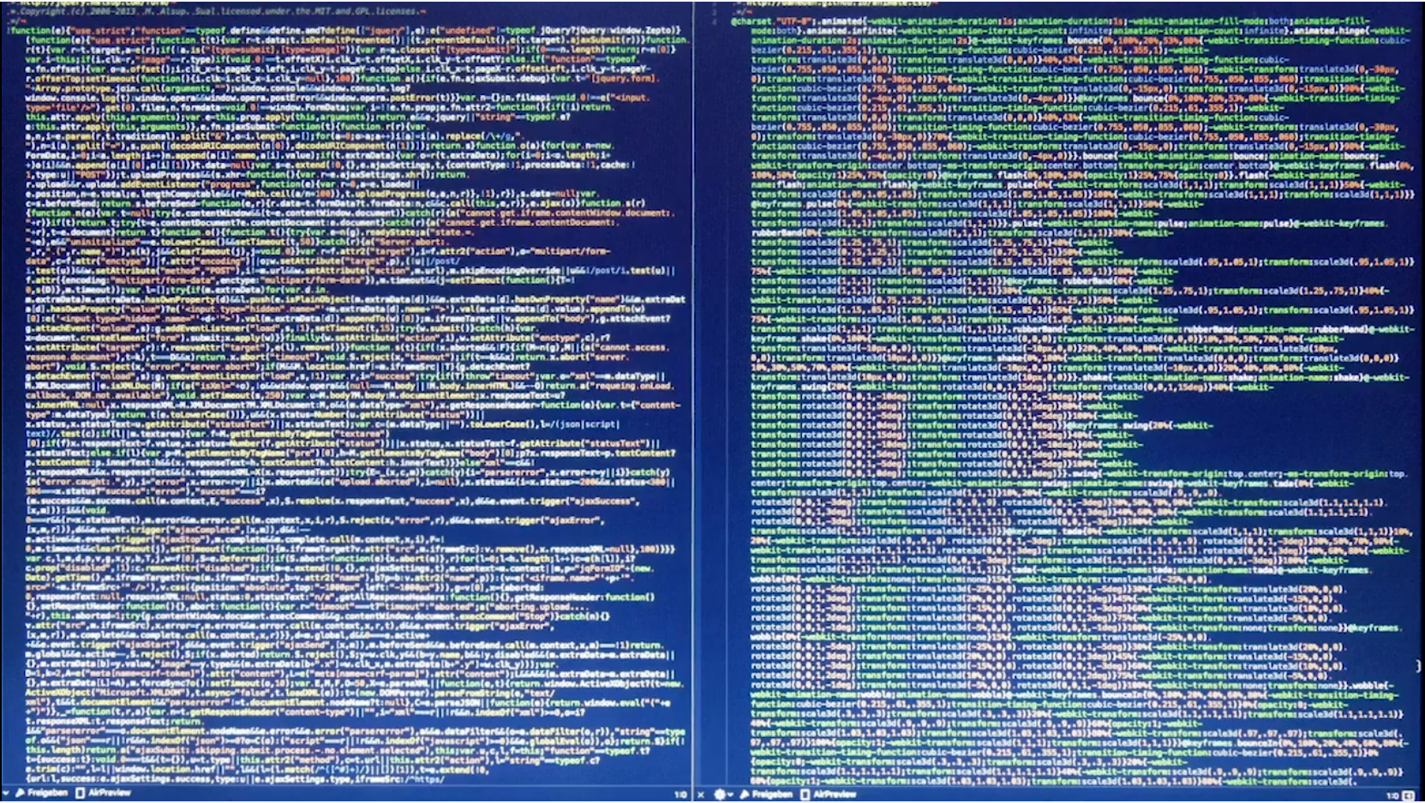
Traditional (explicit) programming to recognize the hand

Slide 21
Traditional (explicit) programming vs ML
Rules
Traditional (explicit) programming
Answers
Data
credit: Laurence Moroney at ML zero to hero

Slide 22
Traditional (explicit) programming vs ML
Answers
Machine Learning
Rules
Data
credit: Laurence Moroney at ML zero to hero

Slide 23
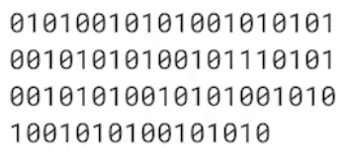
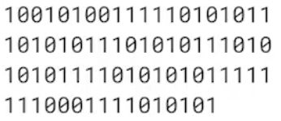
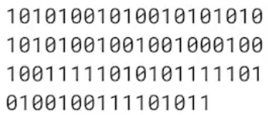
Data and Labels
Label = HAND
Label = HAND
Label = HAND

Slide 24
What is ML?
ML is a subdomain of Computer Science
that
focuses on ALGORITHMS
which
help a COMPUTER learn from DATA
without
EXPLICIT PROGRAMMING
Definition credit: Kylie Ying at freecodecamp.org

Slide 25
What is ML?
A computer algorithm that is said to
learn from experience E
with respect to some task T
and some performance measure P,
if its performance on T, as measured by P, improves with experience E.
Definition credit: Andrew Ng

Slide 26
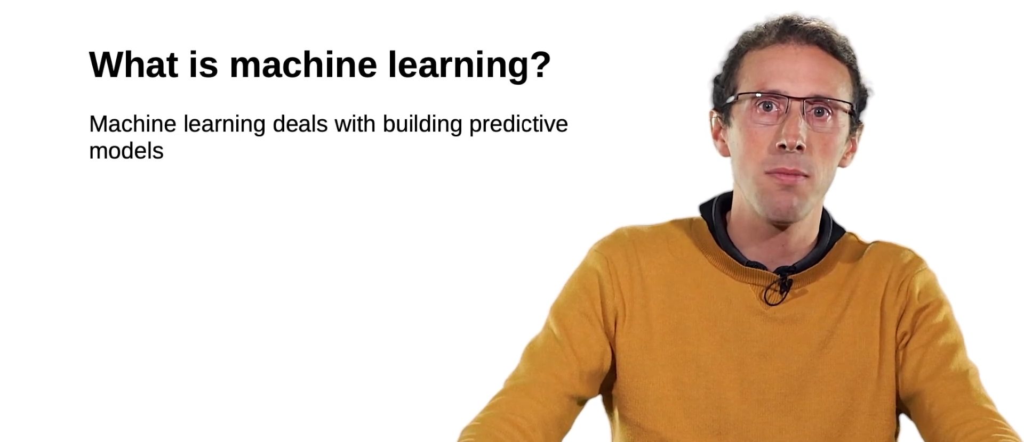
What is ML?

Slide 27
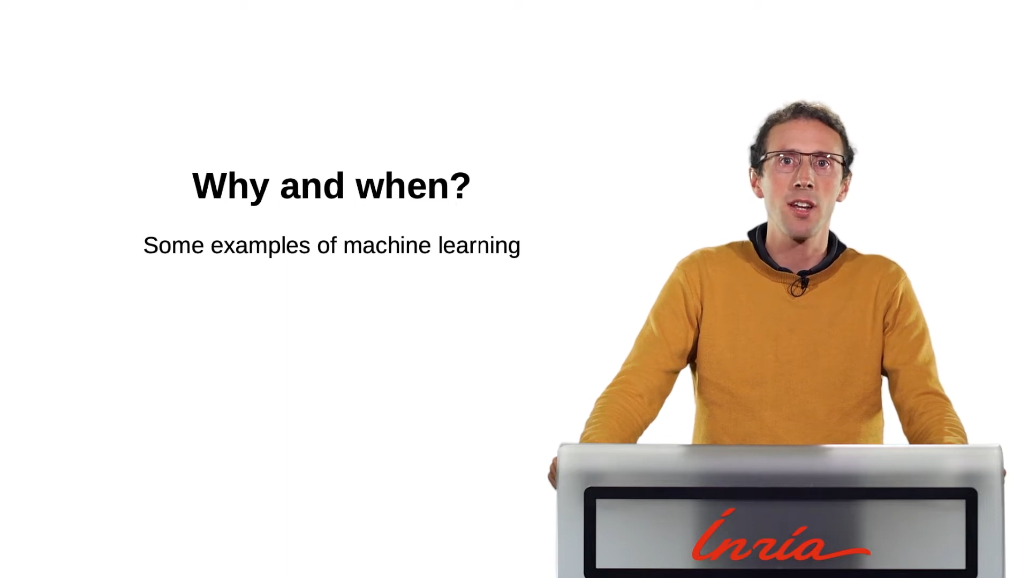

Slide 28
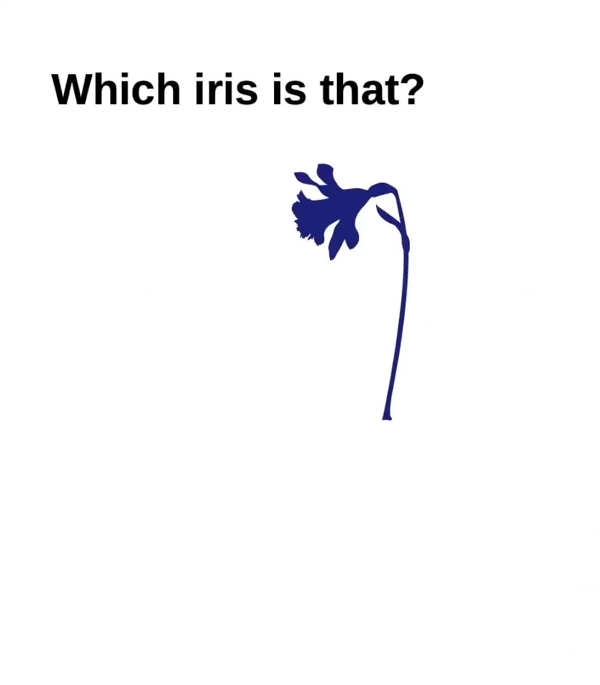

Slide 29
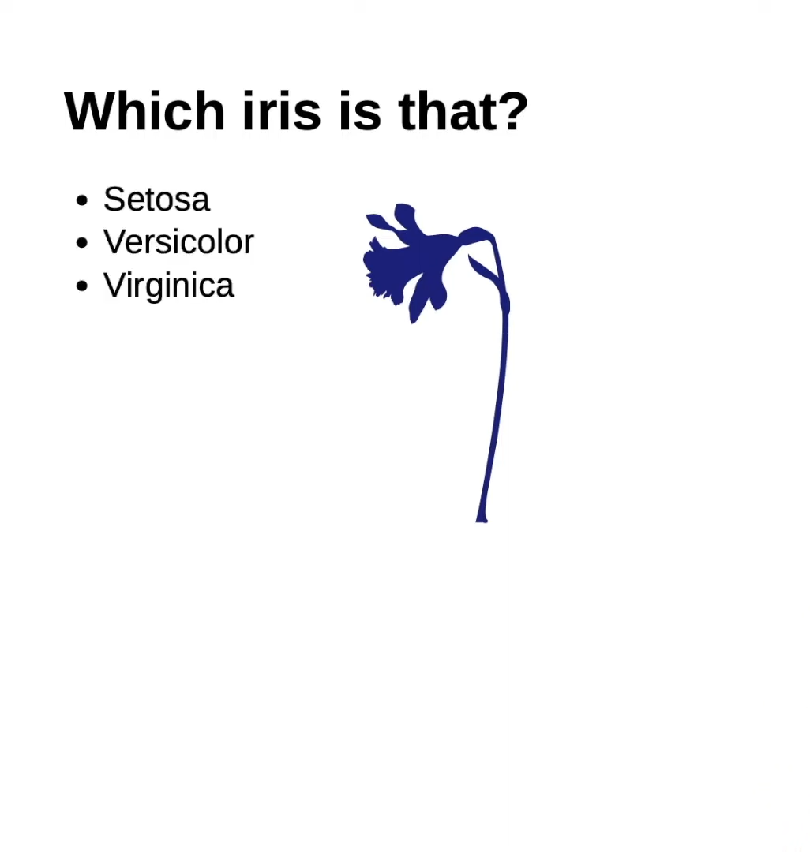

Slide 30
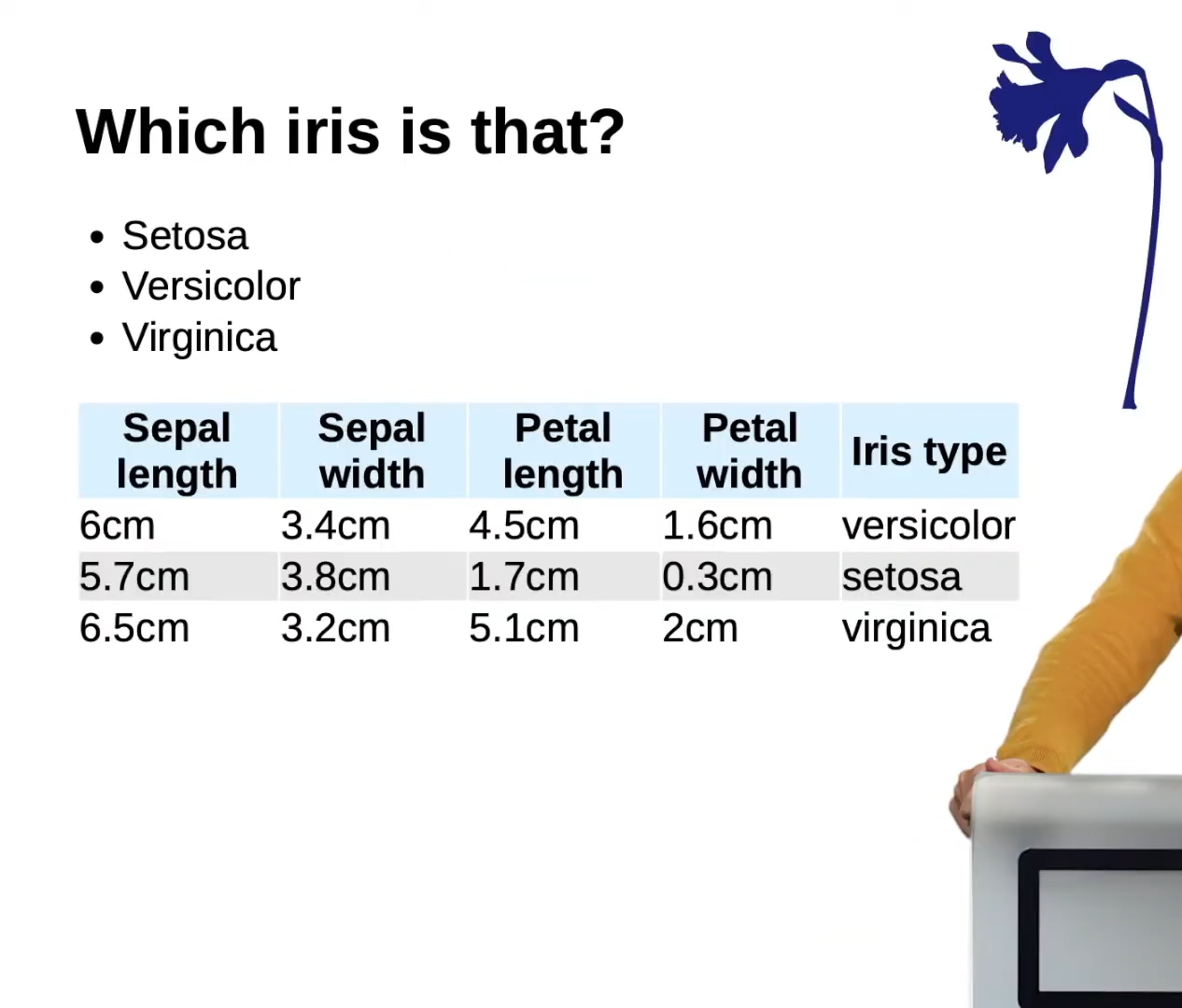

Slide 31
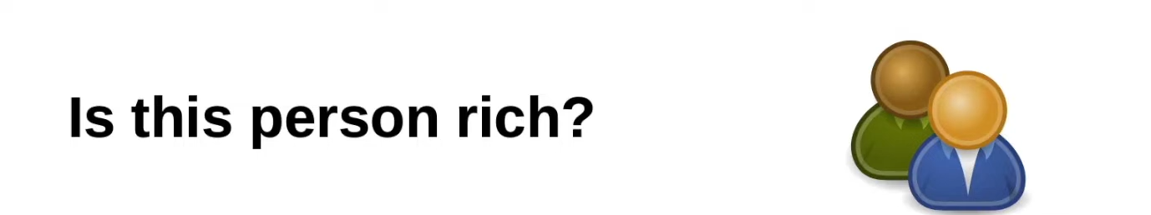

Slide 32
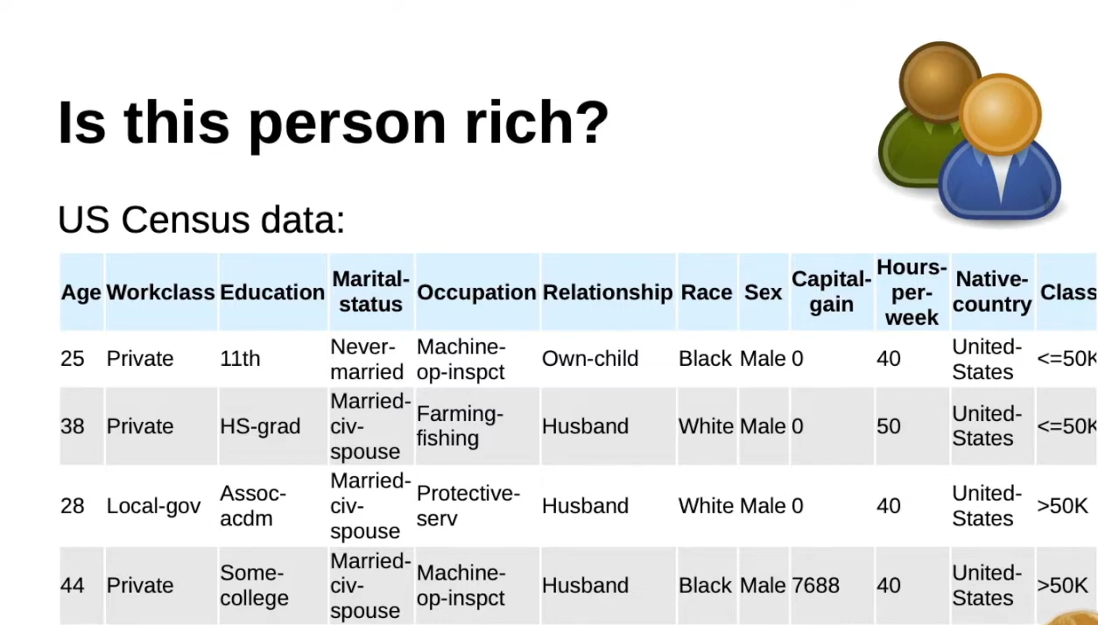

Slide 33
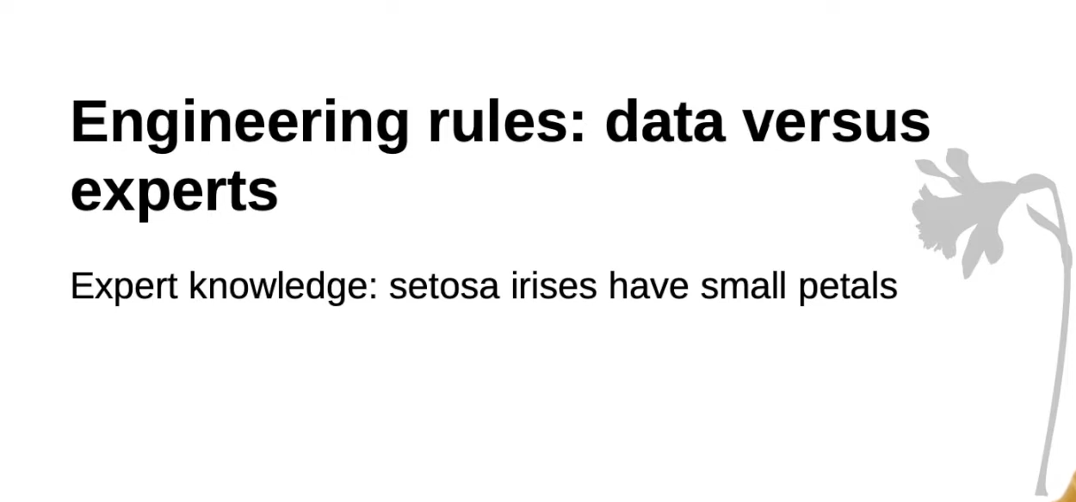

Slide 34
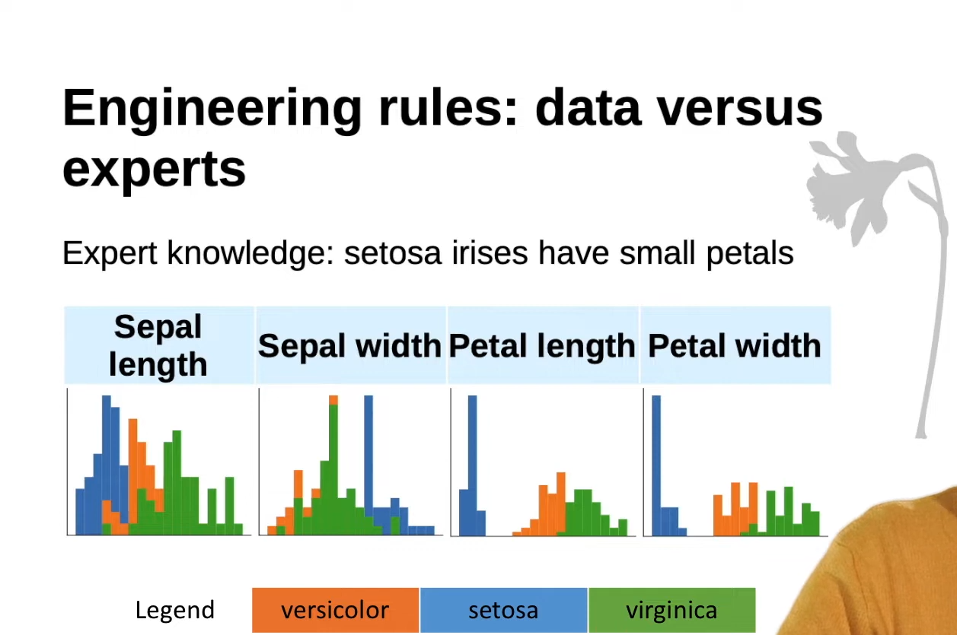

Slide 35
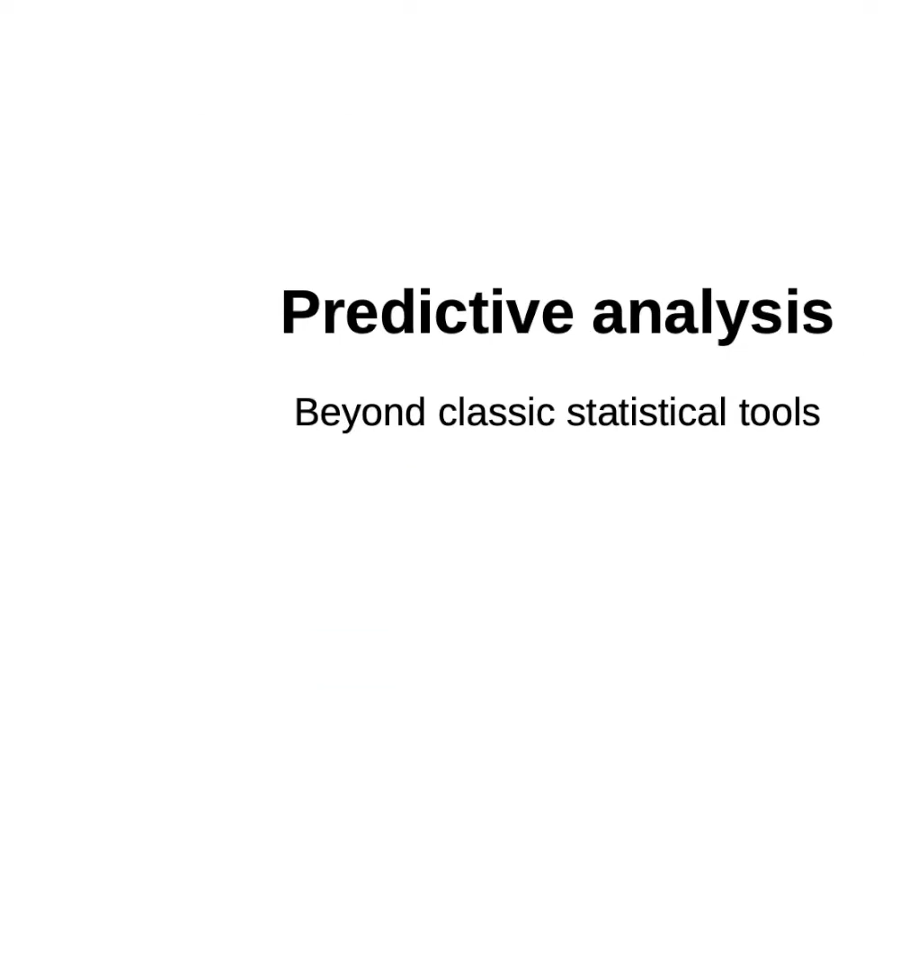

Slide 36
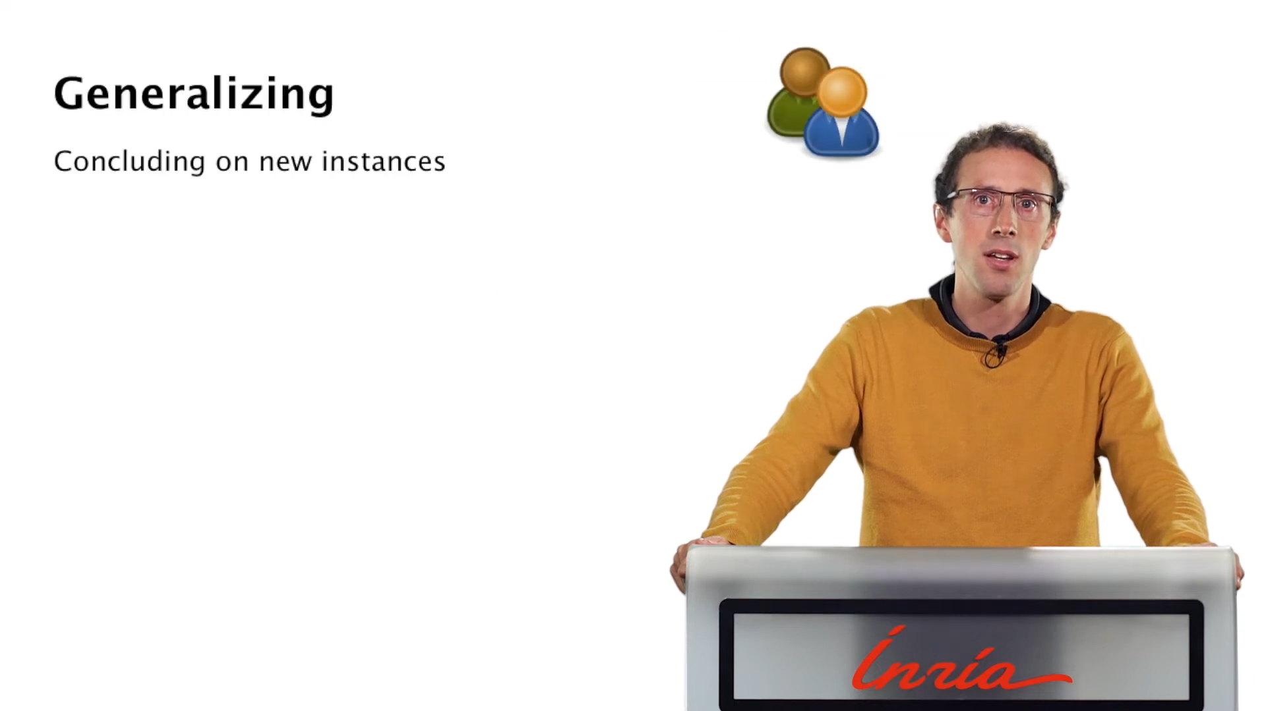

Slide 37
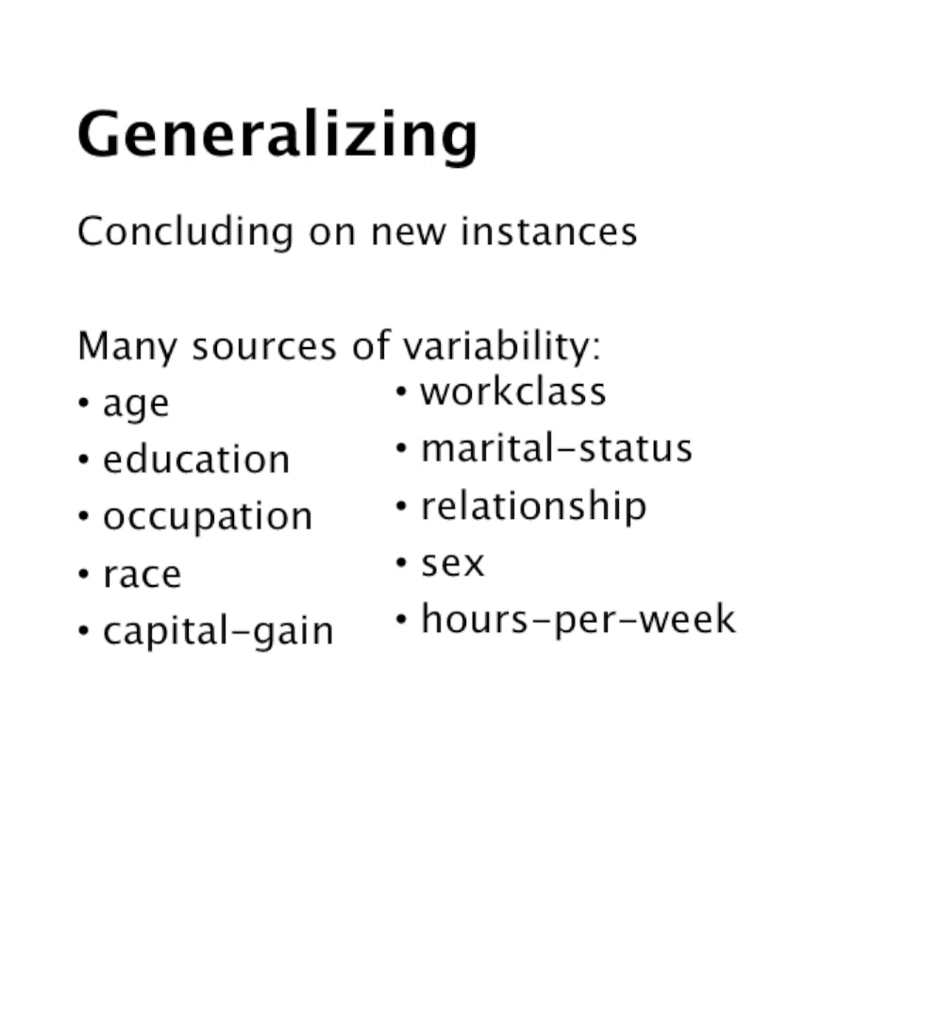

Slide 38
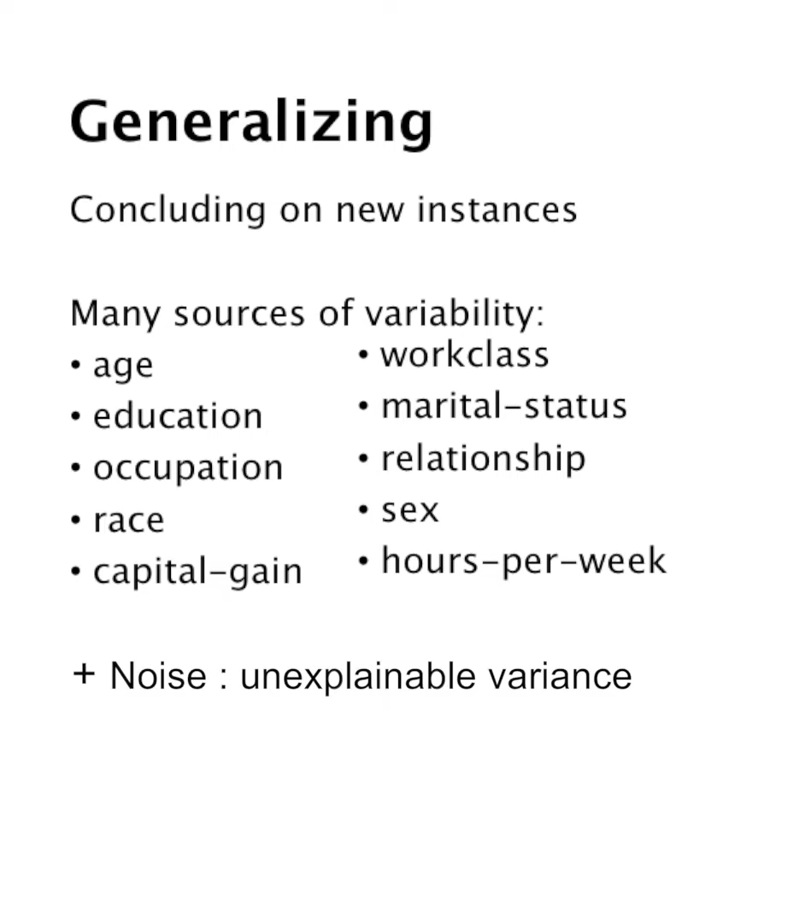

Slide 39
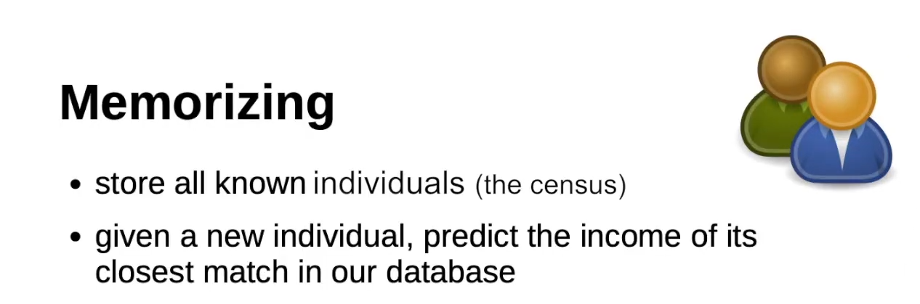

Slide 40
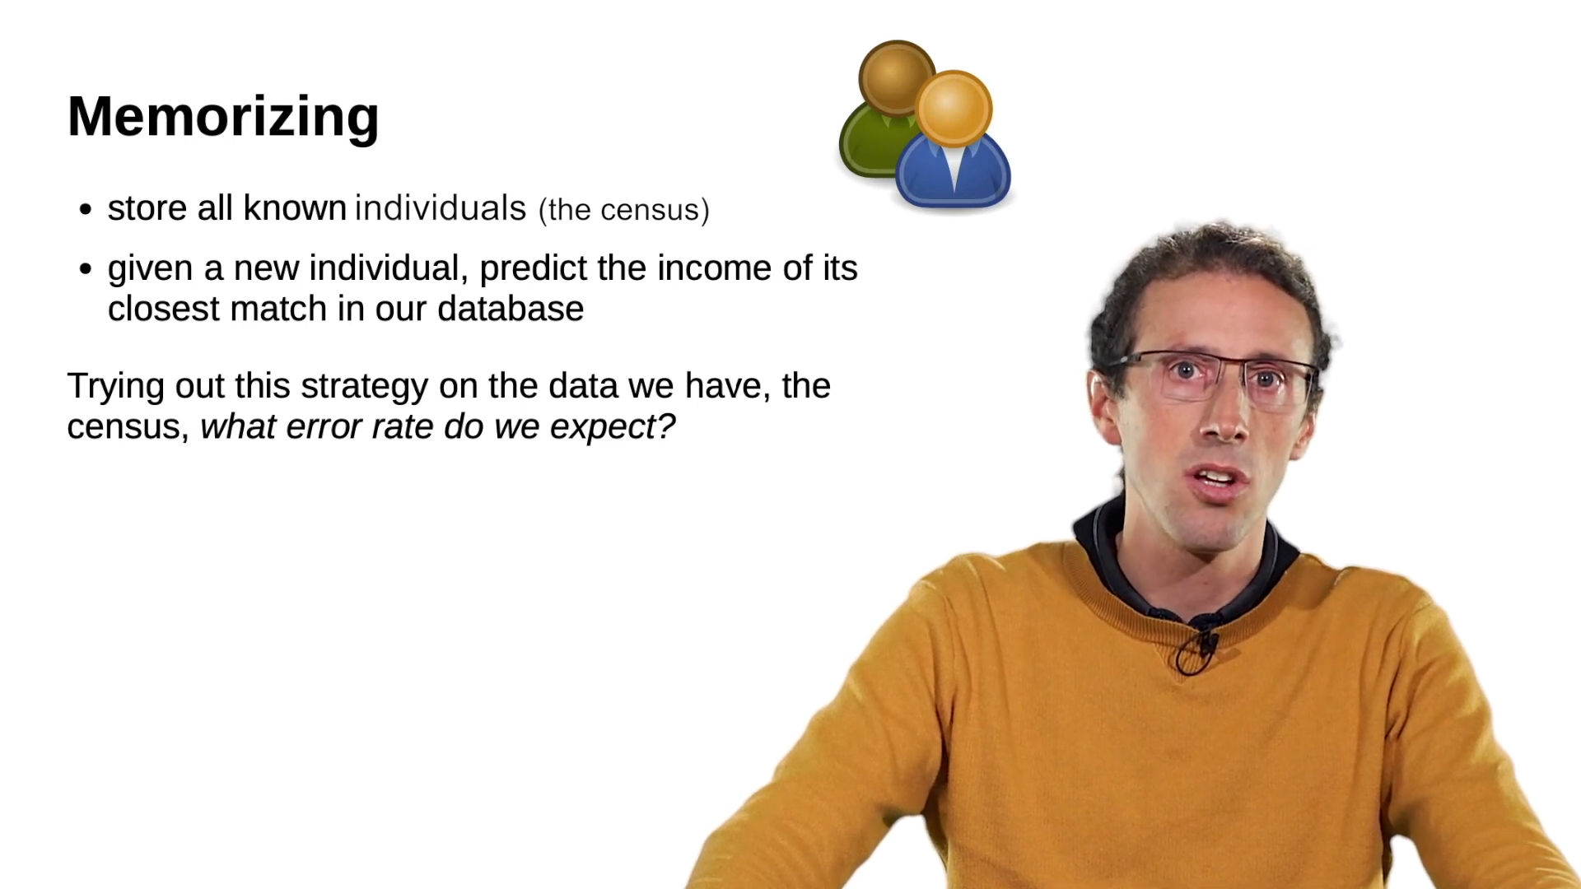

Slide 41
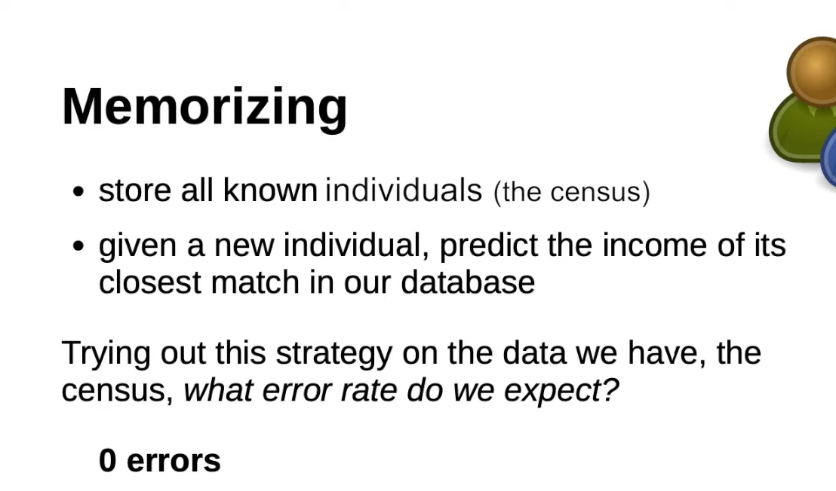

Slide 42
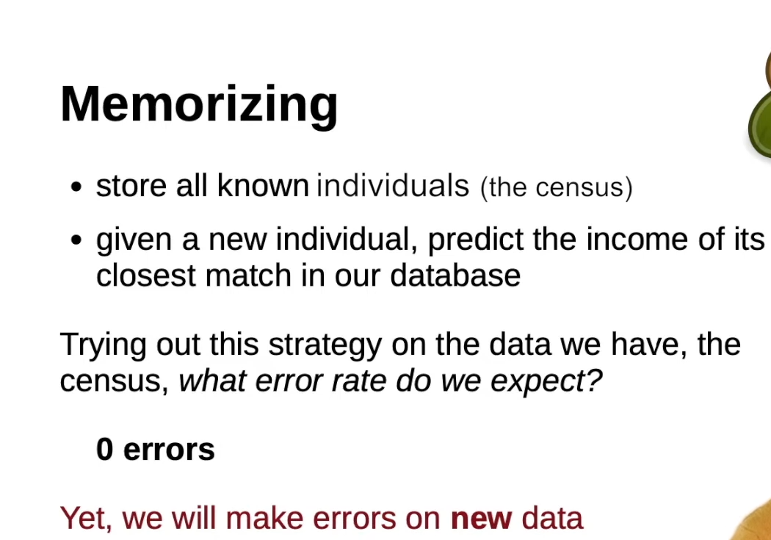

Slide 43
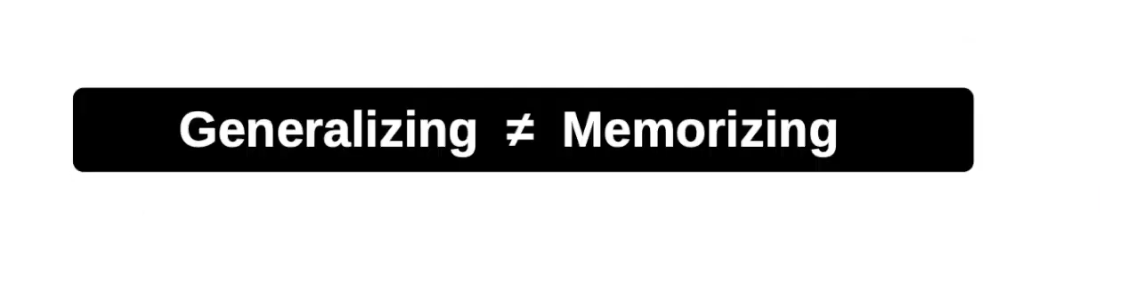

Slide 44
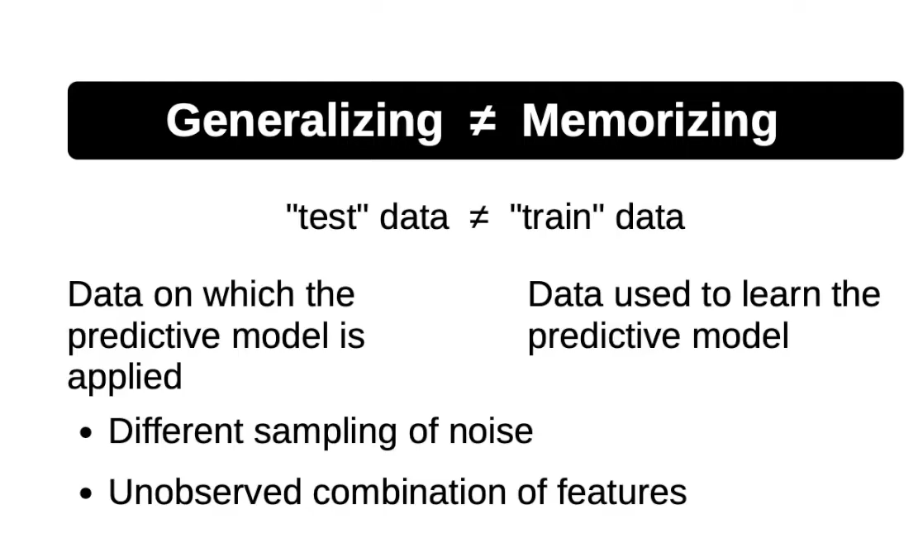

Slide 45
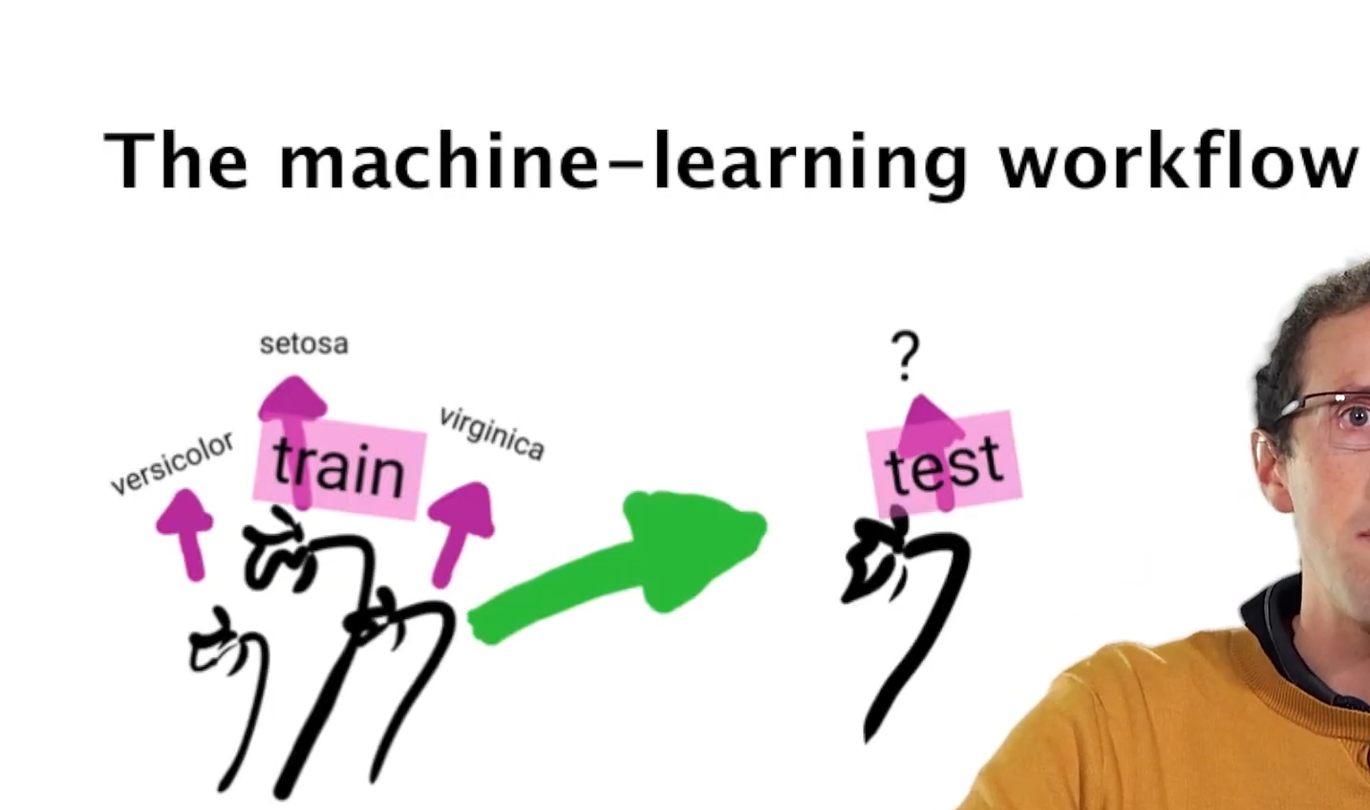

Slide 46
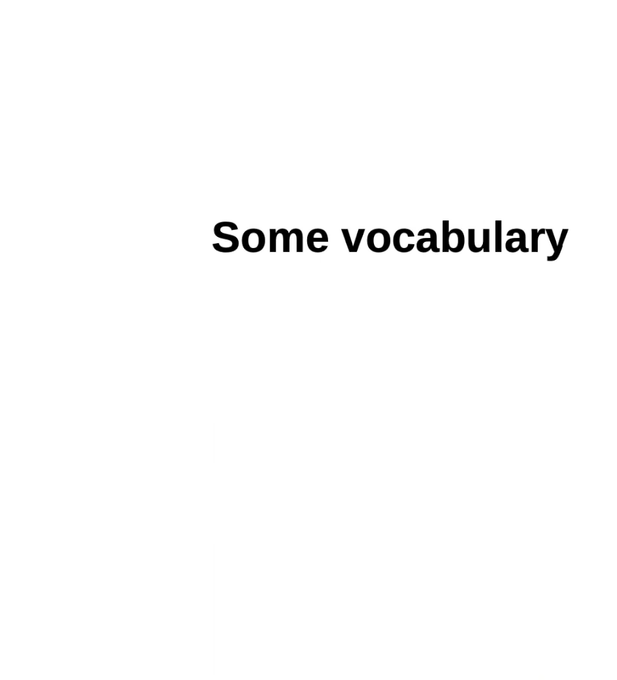

Slide 47
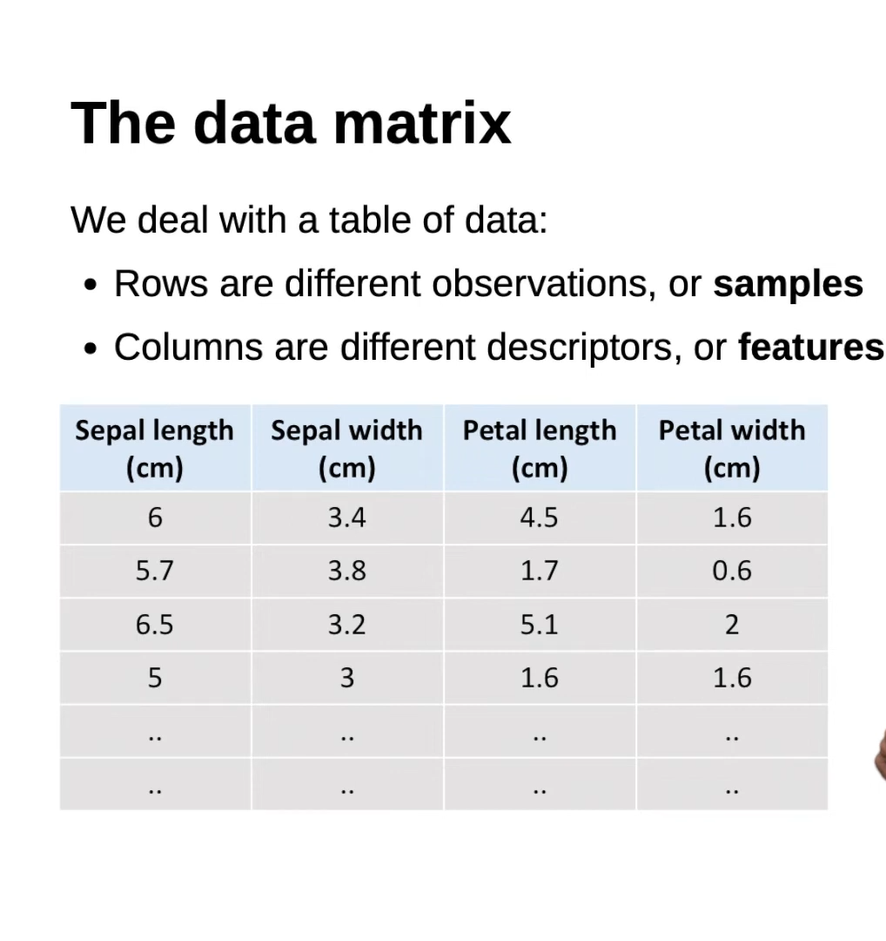

Slide 48


Slide 49
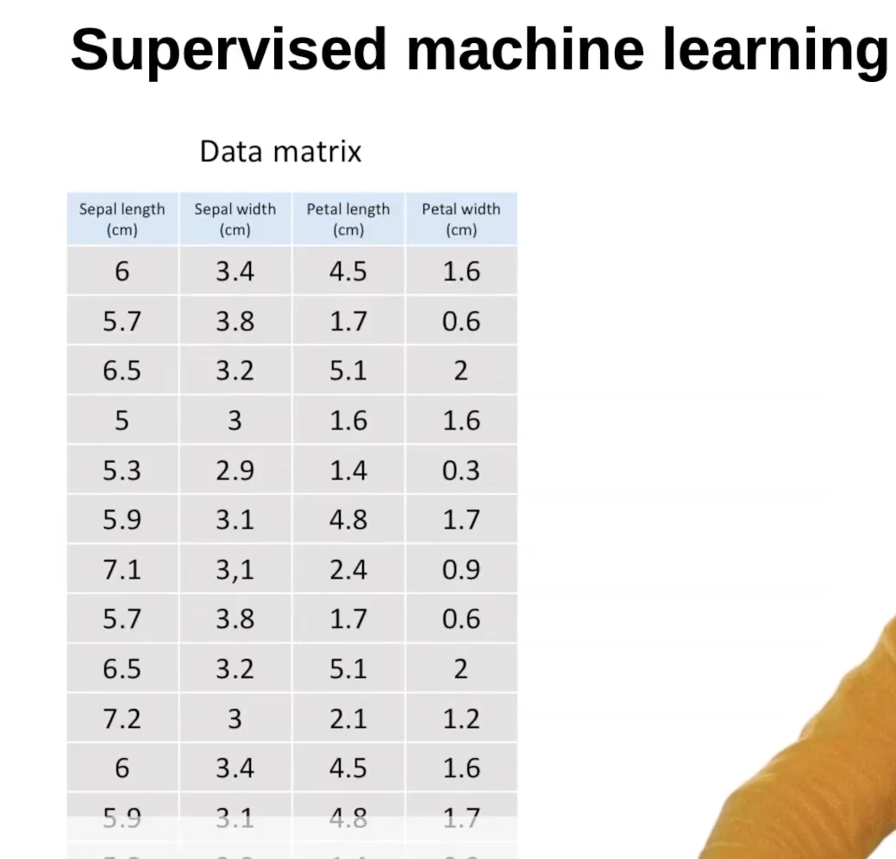

Slide 50
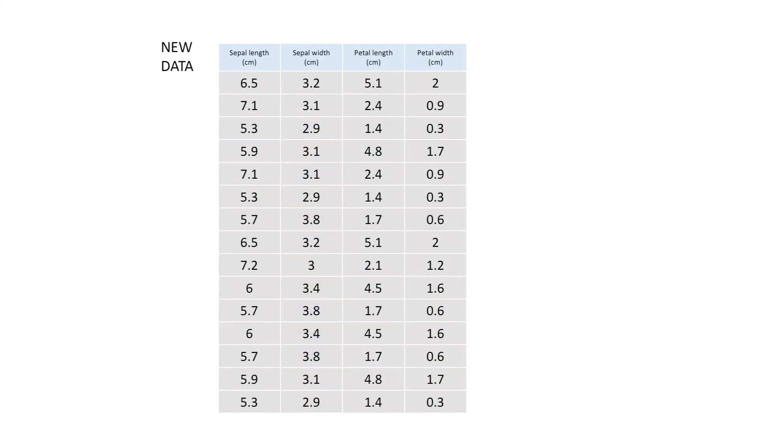

Slide 51
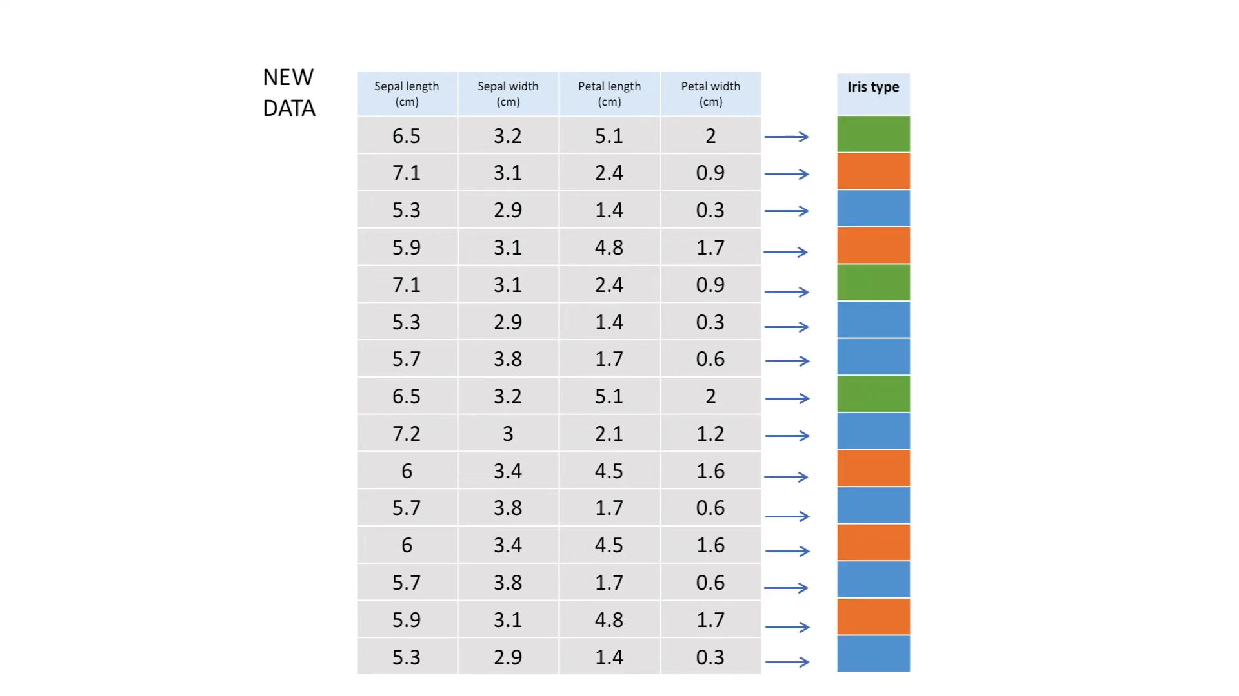

Slide 52
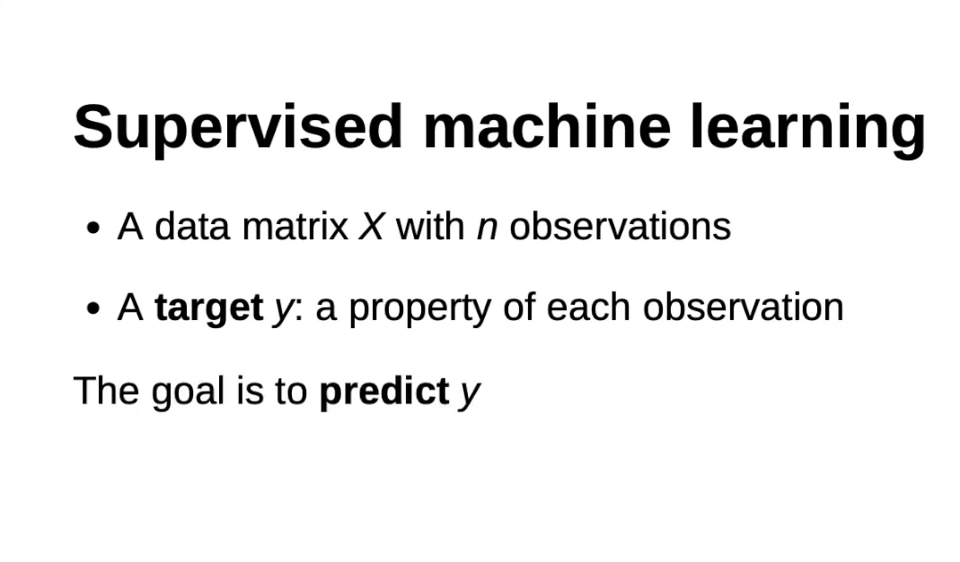

Slide 53
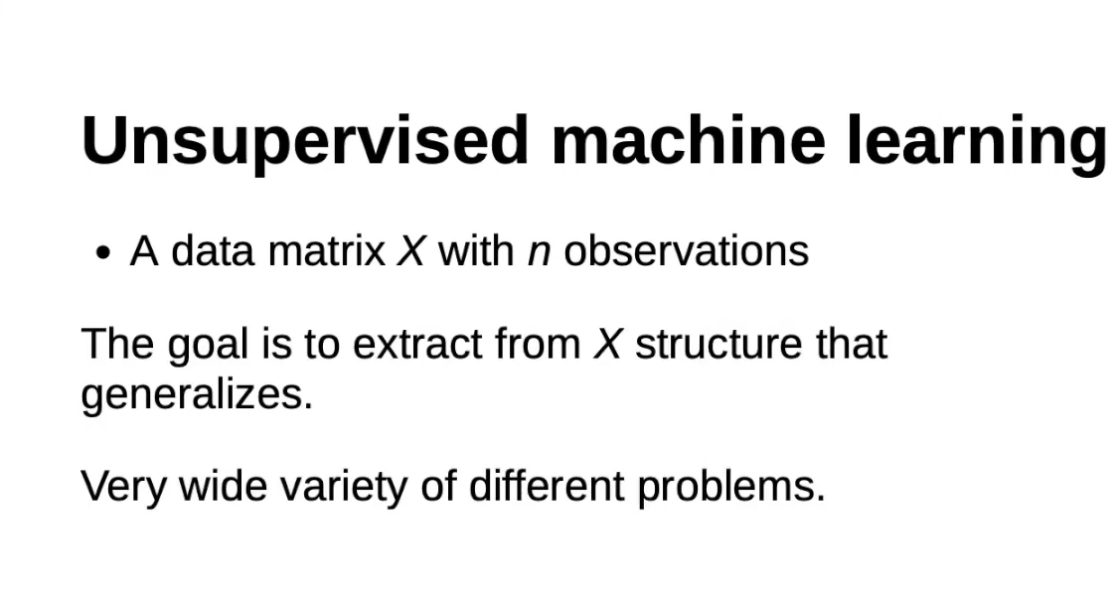

Slide 54
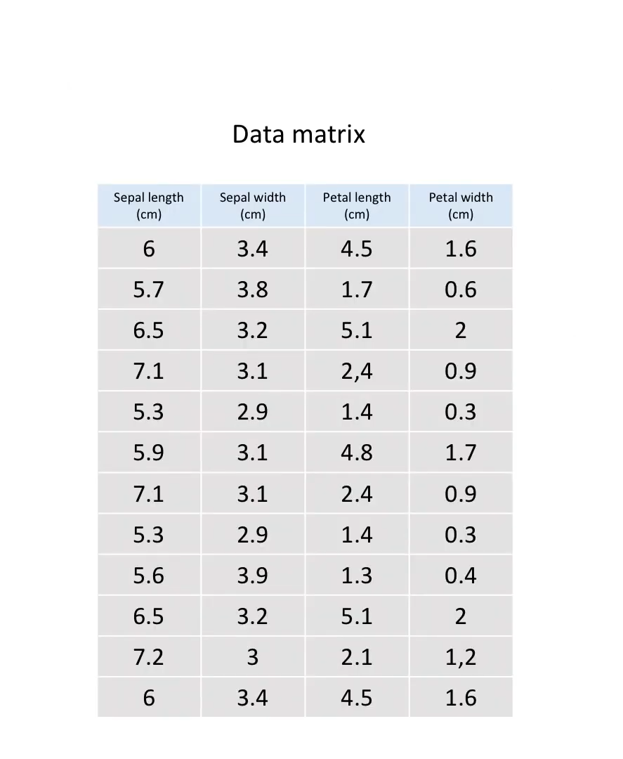

Slide 55
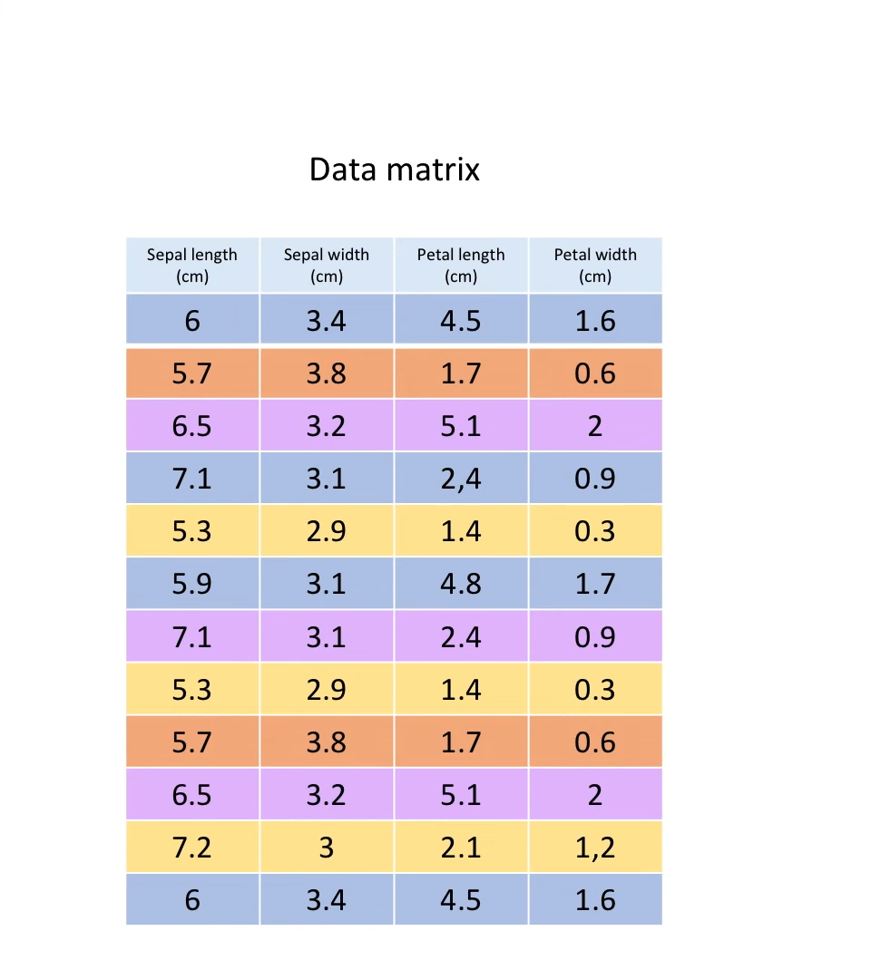

Slide 56
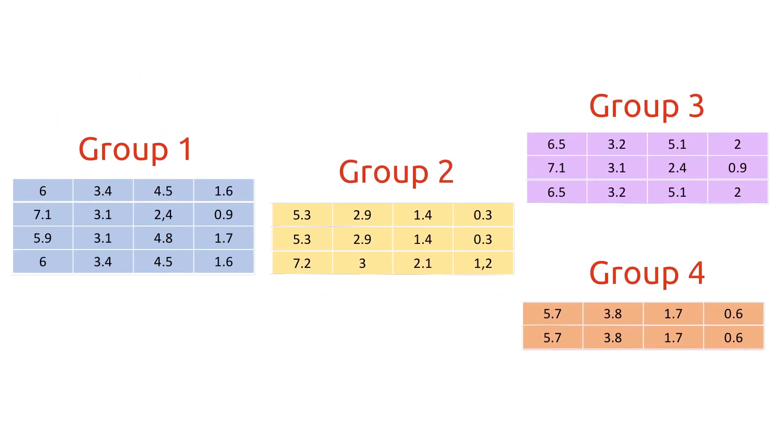

Slide 57
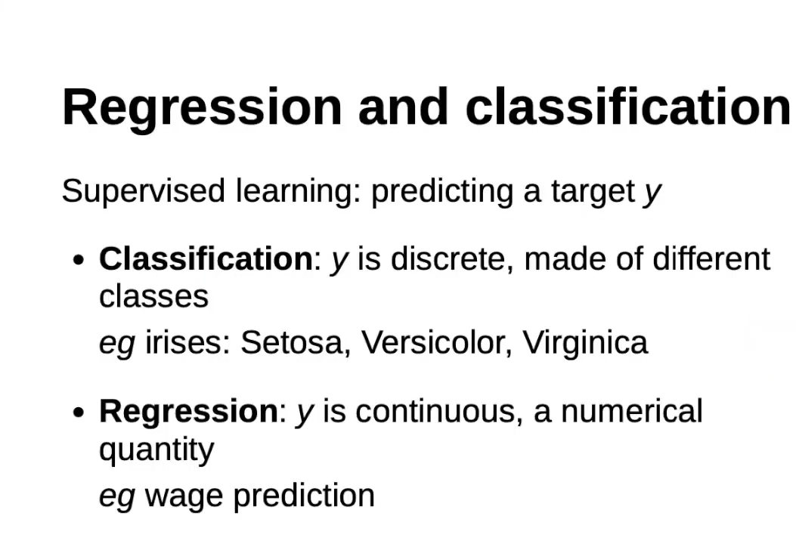

Slide 58
Machine Learning
Machine needs lots of training
2
Image information
Prediction

Slide 59
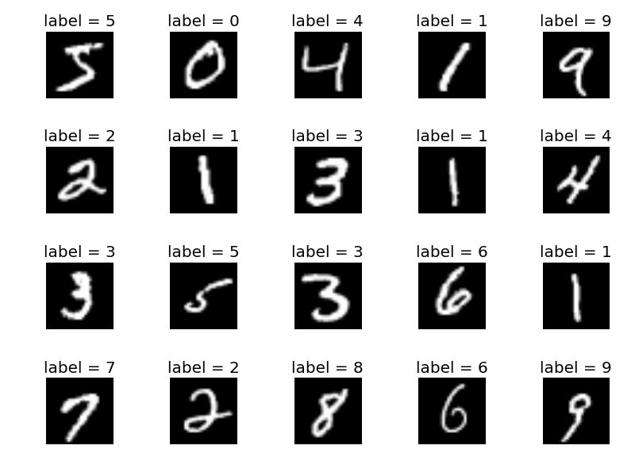
Machine Learning
Machine needs lots of training
Model
training
Labeled dataset

Slide 60
Machine Learning
Predict (test) with trained model
Trained model

Slide 61
Machine Learning
Predict (test) with trained model
Image information
Test dataset
Trained model

Slide 62
Machine Learning
Predict (test) with trained model
2
Image information
Prediction
Test dataset
Trained model

Slide 63
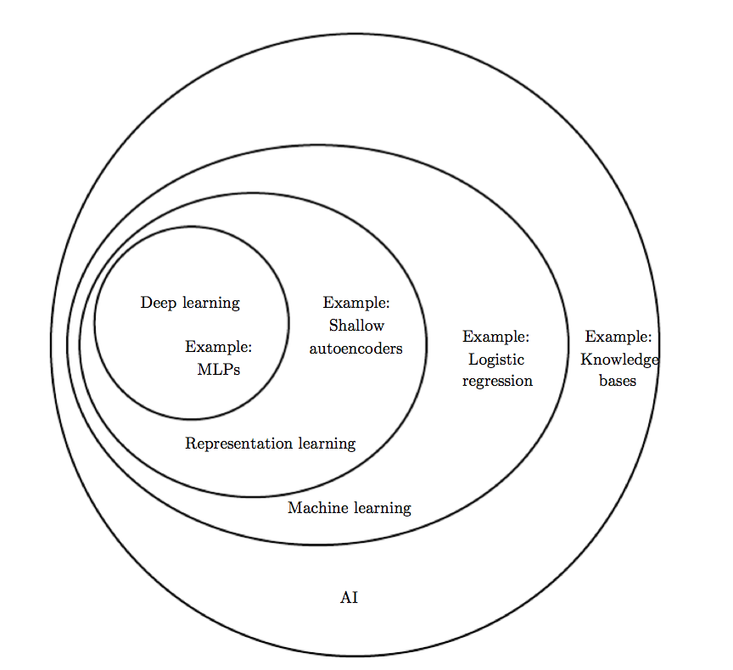
Deep Learning?
Deep Learning by Ian Goodfellow, Yoshua Bengio, Aaron Courville
Notes:
Then, what is deep learning?
More formally, we can explain this terms using this diagram from the Deep Learning book.
Any machine with intelligent, we can call AI, a very broad concept.
One solution for the AI is ML.
There are many algorithms and approaches in ML.
If you are using neural nets and the layers are deep, usually we call it deep learning.

Slide 64
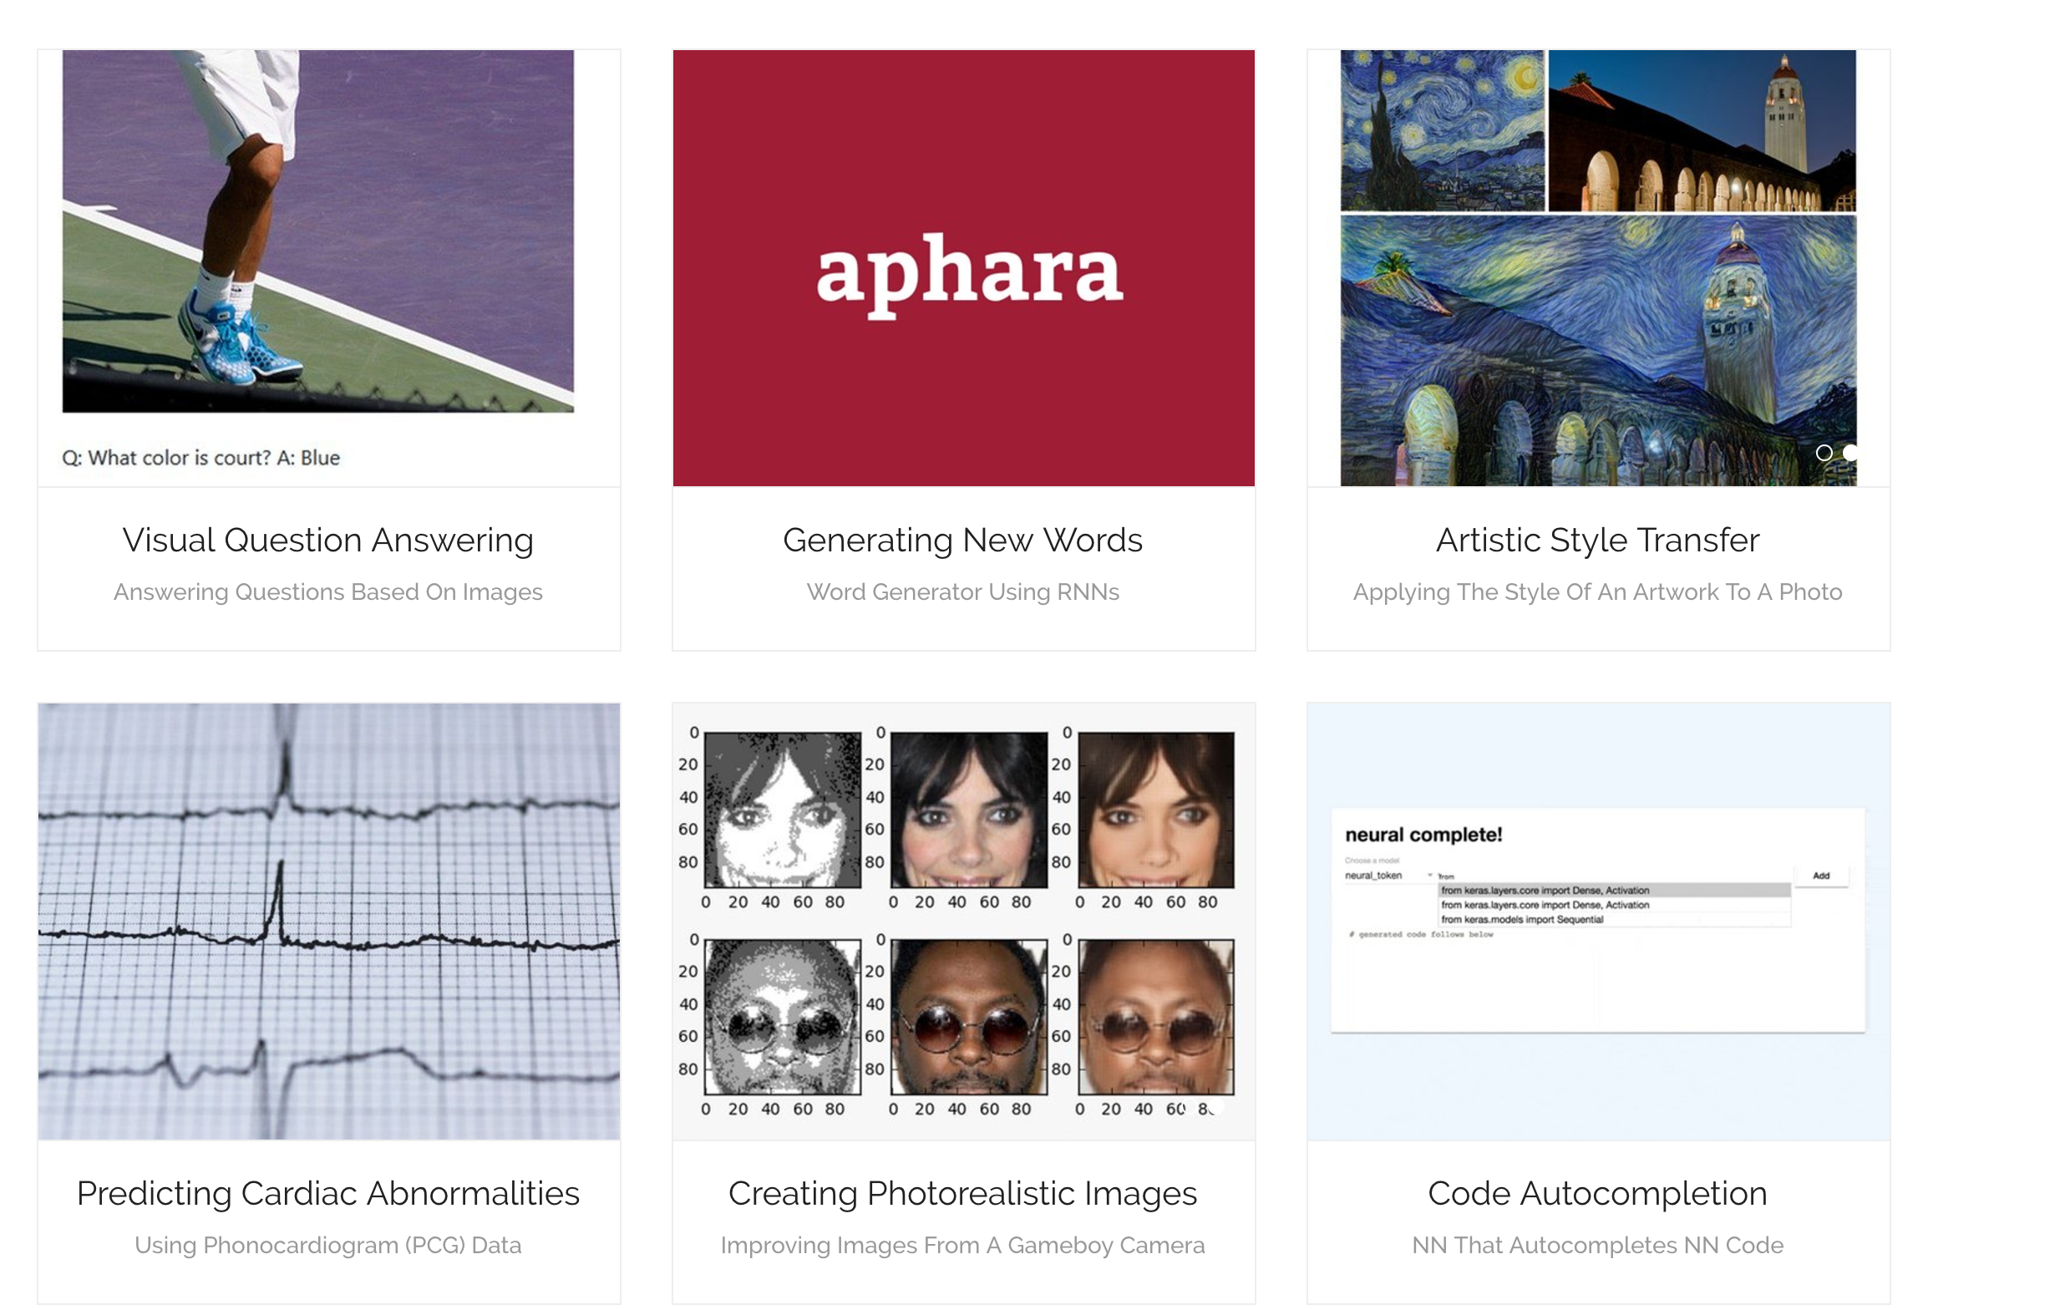
Why We Care?
More demos at https://ml-showcase.com/
Notes:
Why we care so much? Basically, deep learning works. There are many exciting demos including X, Y, and Z.

Slide 65
Applications of Machine Learning

Slide 66
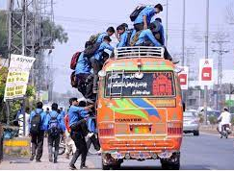
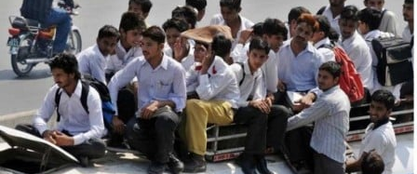
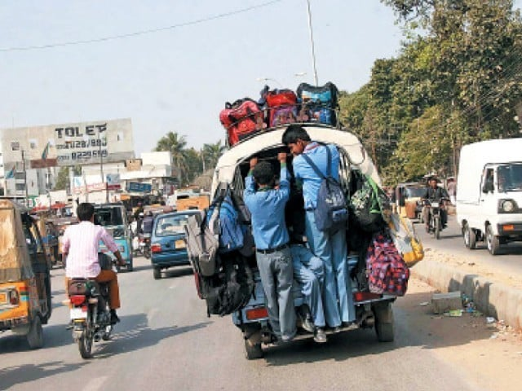
Transportation/Roads safety
Overloaded passenger vehicles detection

Slide 67
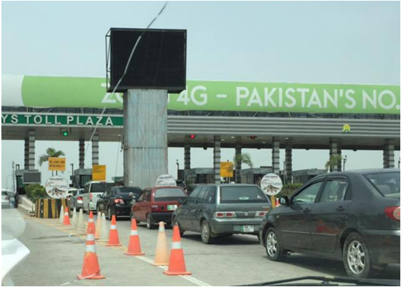
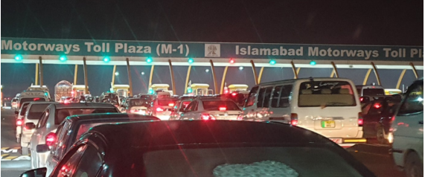
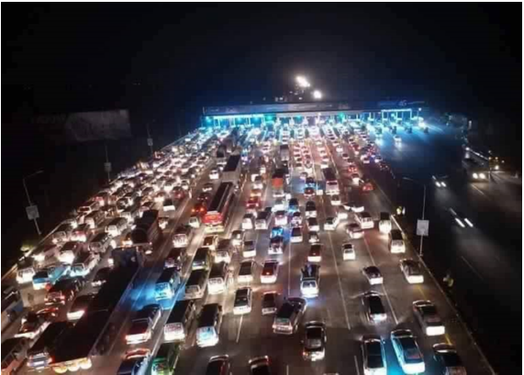
Transportation/Roads safety
Toll automation

Slide 68
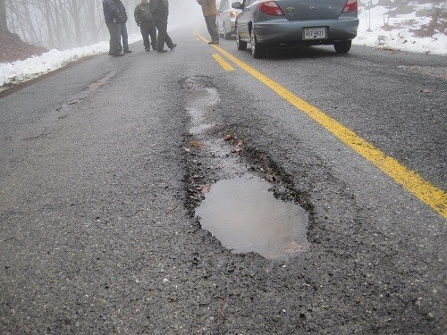


Transportation/Roads safety
Automated roads inspection using UAV

Slide 69




Transportation/Roads safety
Vehicles counting to avoid traffic jam

Slide 70


Transportation/Roads safety
Driver drowsiness detection

Slide 71


Slide 72

Remote health monitoring
IoT enabled wearable sensors-based health monitoring via physical activities recognition
Patel et al. 2012
Journal of neuroengineering and rehabilitation, 9(1), pp.1-17.

Slide 73

Climate change
Extreme weather events detection using ML
Process datasets
using ML
Link the findings to
extreme weather
patterns
Development of climate
services
Climate services
information systems
Source: https://www.uni-giessen.de/de/fbz/zentren/zeu/activities/researchprojects/copy_of_CLINT/PI

Slide 74



Climate change
Change estimation in satellite or UAV imagery

Slide 75





Crowd detection and density estimation
Persons counting in political or religious events

